Slide 1
The 2020 Presidential Election Campaign

Slide 2
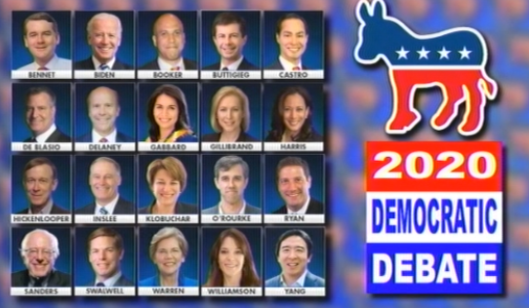
2020 Presidential Election
The Democratic Candidates
More than 20 Democrats ran for president in 2020. Joe Biden was the front-runner, and even after very poor performances in the Iowa Caucus (4th place) and New Hampshire Primary (5th place), Biden emerged as the nominee
President Trump had 3 competitors but none was a serious threat to his nomination as the Republican candidate for president
Notes:
Source: https://electoralvotemap.com/
Red – States that the Republican nominee wins
Blue – States that the Democratic nominee wins
In 2016, had Hillary Clinton been able to win Pennsylvania and Michigan (states where Democrats usually win), then a tie would have occurred in 2016. Surprisingly, Trump won Wisconsin, Michigan, and Pennsylvania.

Slide 3
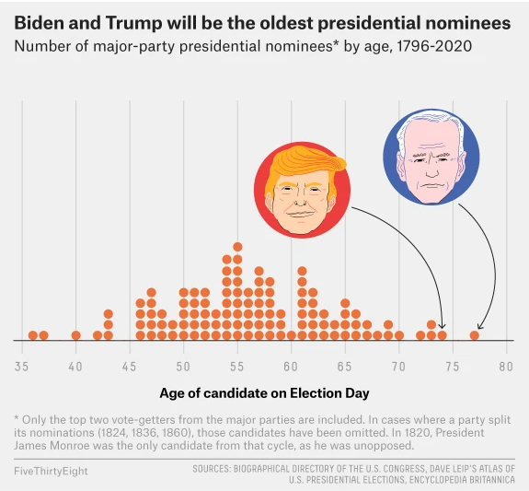
2020 Presidential Election
Biden and Trump are the Oldest in Presidential History
Regardless who wins the 2020 presidential election, the winner will be the oldest president in American history at the time of his inauguration (Jan 20 2021)
Trump turned 74 in Summer 2020, and Biden will turn 78 on Inauguration Day (Jan 20 2020)
Ronald Reagan (1981-1989) was 78 when he completed his second term in office, and he had clear signs of Alzheimer's by the time he was 83
If elected, given his age, Biden will likely be a one-term president
Notes:
Source: https://fivethirtyeight.com/features/what-happens-if-a-presidential-nominee-can-no-longer-run-for-office/
Red – States that the Republican nominee wins
Blue – States that the Democratic nominee wins
In 2016, had Hillary Clinton been able to win Pennsylvania and Michigan (states where Democrats usually win), then a tie would have occurred in 2016. Surprisingly, Trump won Wisconsin, Michigan, and Pennsylvania.

Slide 4
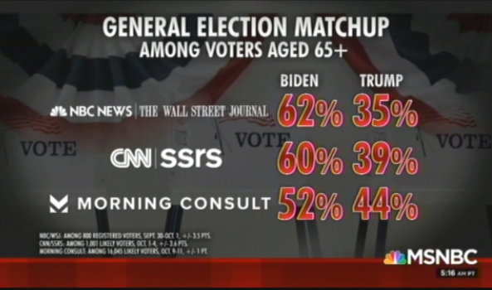
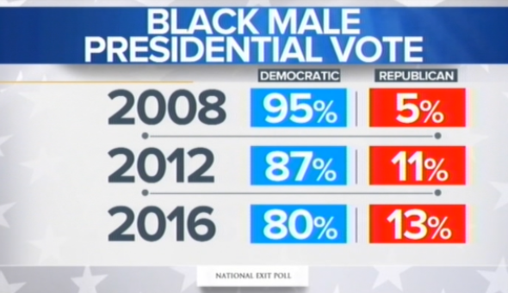
2020 Presidential Election
2020 v. 2016: Changes in Demographic Voting Patterns
In 2016, Trump won the 65+ age group, 52% to 45%. In 2020, polls suggests that this age group is leaning more heavily to Joe Biden, presumably because of Trump’s management of the coronavirus, which affects this age group most
At the RNC Convention (Aug 2020), a number of black men spoke favorably of Donald Trump, one being former NFL star, Hershel Walker. Trump believes he can win the votes of more black men in 2020
Notes:
Source: Morning Joe (October)
Source: MTP (Aug 30 2020)
2020 Exit Polls: National Results 2020 President Exit Polls (cnn.com)
Trump won 65+ voters: 52% to 47%, so Biden picked up 2% of this demographic. The polling on the graphic was off, significantly (presuming we can trust the exit poll, which polled 15,000+ people)
Trump won 19% of black men in 2020, up from 13% in 2016. Biden won 79% of black men, slightly less than Hillary Clinton in 2016. It seems that a lot of the 3rd party black male voters in 2016 switched to Trump in 2020.

Slide 5
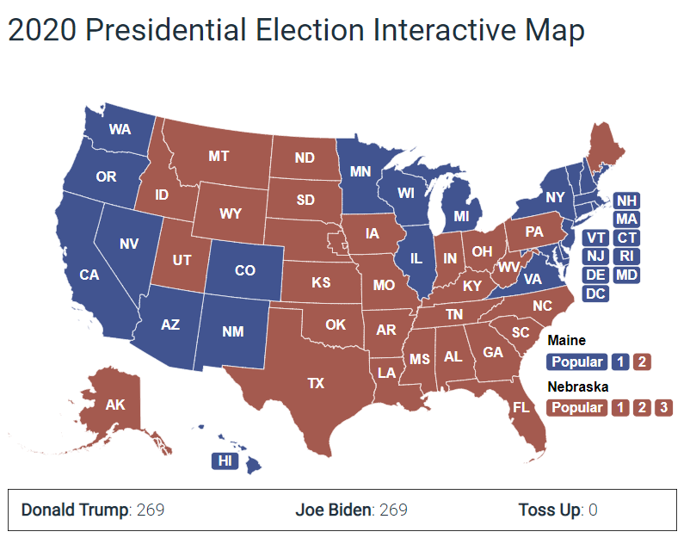
A 269-269 Tie in the Electoral College
Is a Tie a Real Possibility in 2020??
The potential for a tie in the Electoral College is possible on Election Night (2020)
Donald Trump would have to win all or most of the battleground states, just as was the case in 2016
The key state would be Pennsylvania. Biden is favored to win Pennsylvania, but Trump prevailed there in 2016
The Battleground States:
Republican wins: OH, NC, GA, FL, PA, one district in ME
Democrat wins: MN, WI, MI, NH, AZ
Notes:
Source: https://electoralvotemap.com/
If the candidates tie in the Electoral College, then the U.S. House would decide the presidential election, and Trump would have an edge in state-by-state voting in the U.S. House.
Red – States that the Republican nominee wins
Blue – States that the Democratic nominee wins
In 2016, had Hillary Clinton been able to win Pennsylvania and Michigan (states where Democrats usually win), then a tie would have occurred in 2016. Surprisingly, Trump won Wisconsin, Michigan, and Pennsylvania.

Slide 6
The State of the Race Post-DNC and RNC Conventions
Late August 2020 (post-Convention Polls)

Slide 7
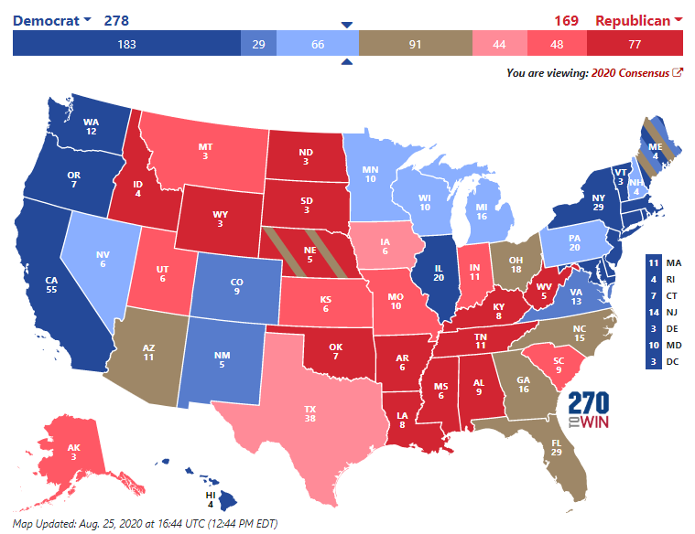
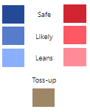
The Battleground States
270towin.com: August 25 2020
According to 270towin.com, according to polling data in the states, if the election were held on Aug. 25th 2020, Biden would win
For Trump to win, he needs to win all of the “battleground” (brown-colored) states—Ohio, NC, Georgia, Florida, and Arizona—plus one more, such as Wisconsin or Minnesota, and one 1 electoral vote from Maine
Trump won the “battleground” states in 2016, plus Michigan, Wisconsin, and Pennsylvania
Notes:
Source: http://www.270towin.com/
Date: Aug 25 2020

Slide 8
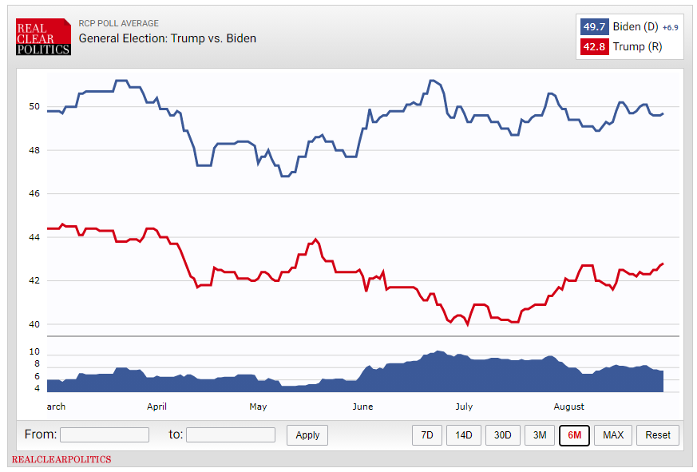
Presidential Polling
RealClearPolitics.com (August 25 2020)
RealClearPolitic.com averages the polling results of reputable polling organizations over time
As of Aug. 25, 2020, Joe Biden has a 6.9% lead in average nationwide polling over Donald Trump
On this date in 2016, Hillary Clinton held a 4.5% lead over Donald Trump
Notes:
Source: https://www.realclearpolitics.com/epolls/2020/president/us/general_election_trump_vs_biden-6247.html
Date: Aug 25 2020

Slide 9
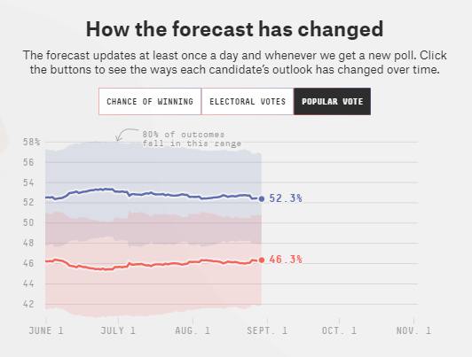
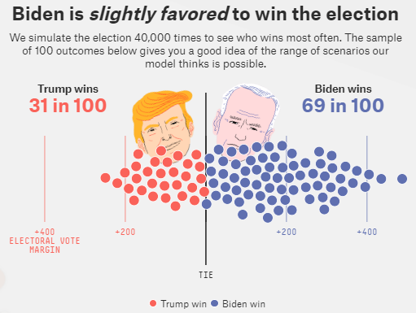
Presidential Polling
FiveThirtyEight.com (August 28 2020)
FiveThirtyEight.com forecasts (predicts) who will win a presidential election, using polling data and other factors
As of August 26, 2020, Joe Biden has a 6% lead in the “538” prediction as to what it believes will be the nationwide vote
FiveThirtyEight.com predicts that Biden has a 69% likelihood of winning the election.
In 2016, “538” predicted that Hillary Clinton had a 73% likelihood of winning, which simply indicates that political science is not an exact science
Notes:
Source: https://projects.fivethirtyeight.com/2020-election-forecast/
Date: Aug 28 2020

Slide 10
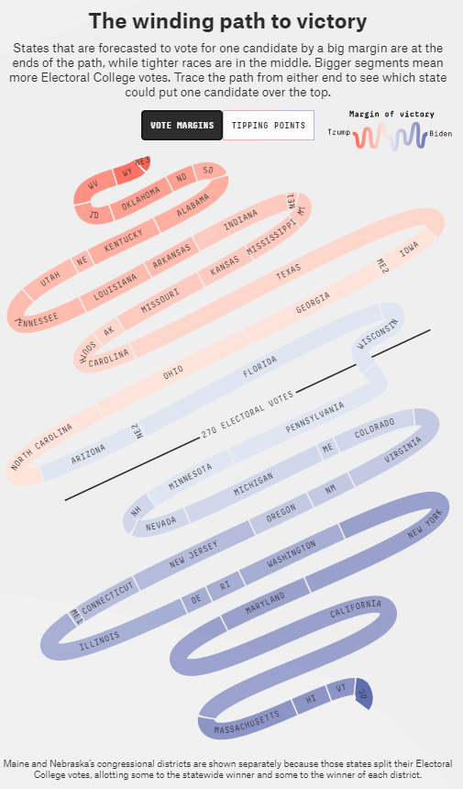
Presidential Polling
FiveThirtyEight.com
“538” graphically depicts the states in the form of a snake, with the battleground states as being close to the “270 electoral votes” demarcation line
Here are the states potentially up for grabs (Aug 28 2020, 9 weeks prior to election):
Trump leads slightly in: Texas, Iowa, Maine (one district), Georgia, Ohio, and North Carolina
Biden leads slightly in: Arizona, Nebraska (one district), Florida, Wisconsin, Pennsylvania, and Minnesota
Notes:
Source: https://projects.fivethirtyeight.com/2020-election-forecast/
Date: Aug 28 2020
Maine and Nebraska are the only two states that (potentially) split their electoral votes. The winner of a majority of the statewide vote receives 2 electoral votes, and then the vote winner in each congressional district wins 1 electoral vote for winning that district. Nebraska has 3 congressional districts, and Maine has two. In 2016, Trump one congressional district in Maine, and Hillary Clinton won the other

Slide 11
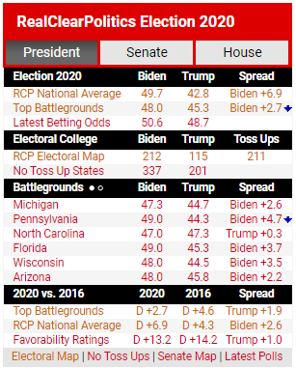
Presidential Polling
RealClearPolitics.com (August 25 2020)
As of Aug. 25, 2020, Biden leads in all but one of the “battleground” states, though the margins (difference between Biden and Trump) are within 5%, and when polling is within a 5% margin, the state is considered a “toss up.”
Hillary Clinton had a larger average lead in the “battleground” states, a 4.6% lead over Donald Trump, while Biden has an average lead 0f 2.7% in the “toss up” states in 2020
Notes:
Source: https://www.realclearpolitics.com/
Date: Aug 25 2020

Slide 12
Policy and Valence Issues
Candidate Advantages – Policy and Valence

Slide 13
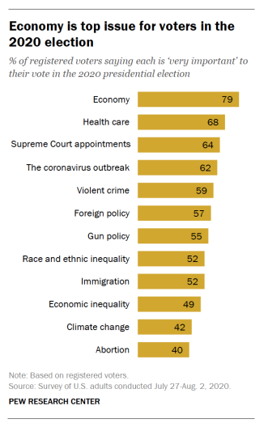
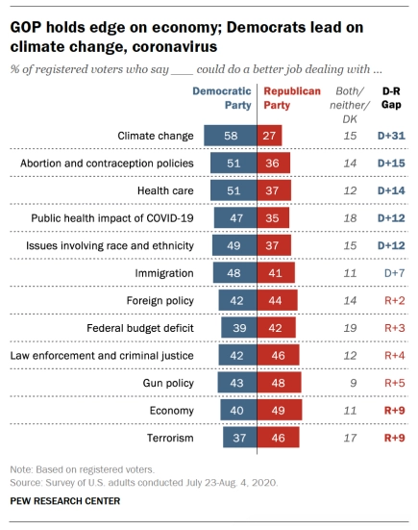
2020 Presidential Campaign
The Most Important Policy Issues
Voters evaluate the positions the candidates take on the issues and their personal traits (“valence” issues). It seems that the economy, COVID-19, race/equity, and law enforcement/violence are getting the most attention in the news, and these are issues that are of concern to the voters
Issues getting lots of news coverage are top issues for registered voters
Biden’s advantages
Trump’s advantages
Notes:
https://www.pewresearch.org/politics/2020/08/13/important-issues-in-the-2020-election/

Slide 14
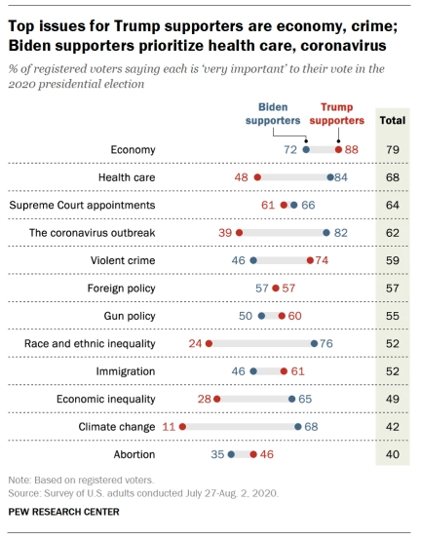
2020 Presidential Campaign
The Most Important Policy Issues
On the issues where Republican and Democratic voters are most polarized (i.e., where they have the greatest differences), these voters are more likely to be motivated to vote for or against a candidate on those issues
Polling shows that Republican and Democratic (registered) voters are most polarized on:
Climate Change (57% difference)
Race and Ethnic Inequality (52% difference)
The Coronavirus Outbreak (43% difference)
Heath Care (36% difference)
The issues getting the most attention in the news are “race and ethnic inequality” and “the coronavirus outbreak,” and both favor Biden (also see previous slide)
Notes:
https://www.pewresearch.org/politics/2020/08/13/important-issues-in-the-2020-election/

Slide 15
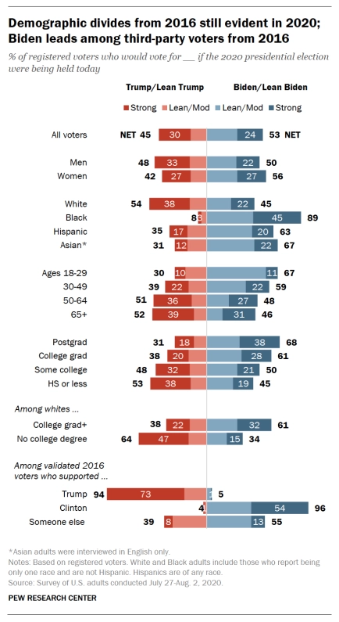
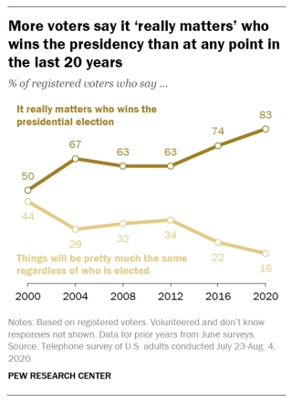
2020 Presidential Campaign
The Most Important Policy Issues
In 2016, given such high voter dissatisfaction with both Hillary Clinton and Donald Trump, 12% of voters voted for a 3rd party, which is about 4 times higher than usual (about 3% usually vote for a 3rd party)
In 2020, since voters perceive the stakes to be so high, many of those 3rd party voters are more likely to choose either Biden or Trump, and a majority (55%) are polling in favor of Biden, while 39% are favoring Trump
Notes:
https://www.pewresearch.org/politics/2020/08/13/important-issues-in-the-2020-election/

Slide 16
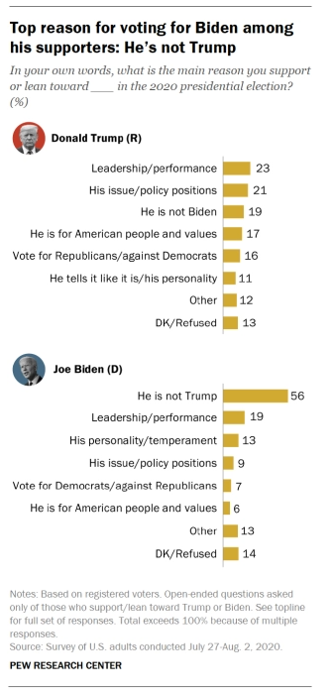
2020 Presidential Campaign
The Most Important “Valence” (Personal Traits) Issues
Voters evaluate the personal traits (“valence” issues) of the candidates. At both national conventions (August 2020), the narrative was aimed at either improving or debunking perceptions of the candidate’s traits.
The narrative at the DNC was to promote the personal traits of Joe Biden (as a good and decent man), and the narrative at the RNC was to debunk the negative perceptions of Trump (i.e., to debunk the notion that Trump is narcissistic, misogynistic, and racist)
In 2020, 23% of potential Trump voters like Trump’s leadership as president in his first term. In 2016, Republican voters were attracted to Trump’s willingness to “tell it like it is”
56% of potential voters for Biden favor him because “he is not trump,” which is not necessarily an endorsement of Biden being a “good and decent man,” but it is a negative evaluation of Trump’s personal traits
Notes:
https://www.pewresearch.org/politics/2020/08/13/important-issues-in-the-2020-election/
DNC – Democratic National Convention
RNC – Republican National Convention

Slide 17
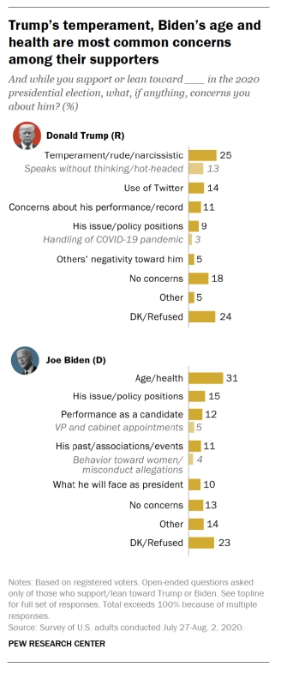
2020 Presidential Campaign
The Most Important “Valence” (Personal Traits) Issues
Biden was portrayed at the DNC as a “good and decent” person, in contrast to the type of person Trump is perceived to be
To counter the perception of Trump as a narcissist and child, the RNC portrayed Trump as caring about others (e.g., “right to try” experimental drugs, negotiating the release of hostages in foreign countries, granting pardons to those who have received unjust sentences), as helping women succeed, and by black supporters as being non-racist
What both political conventions emphasized indicates that both believe that personal traits are important to voters
In 2020, 39% of potential Trump voters are concerned that his personal traits (e.g., being perceived as narcissistic and attacking people on Twitter) may doom his chances of winning in 2020
31% of potential voters for Biden worry that his age/health (e.g., early signs of dementia) may jeopardize his chances of winning in 2020
Notes:
https://www.pewresearch.org/politics/2020/08/13/important-issues-in-the-2020-election/
DNC – Democratic National Convention, held in August 2020
RNC – Republican National Convention, also held in August 2020

Slide 18
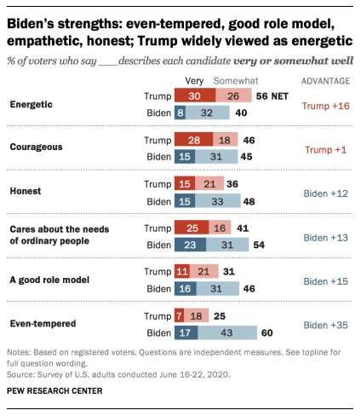
2020 Presidential Campaign
The Most Important “Valence” (Personal Traits) Issues
Trump hopes that voters will appreciate and reward his “energetic” style, in contrast to Biden, who has laid low at home (prior to the national conventions and in accordance with CDC guidelines to help contain COVID-19)
Biden hopes that voters will appreciate and reward his being “even-tempered,” in contrast to Trump’s tirades against his political opponents and the media, as well as his Twitter rants
Notes:
https://www.pewresearch.org/politics/2020/06/30/publics-mood-turns-grim-trump-trails-biden-on-most-personal-traits-major-issues/

Slide 19
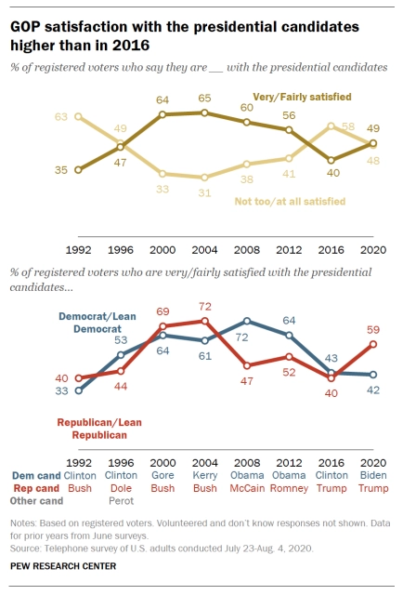
2020 Presidential Candidates
Voter Satisfaction (or Enthusiasm) in Perspective
In June 2016, only 40% of registered Republican voters were satisfied with Donald Trump as the Republican candidate
In July-August 2020, 59% of registered Republican voters are satisfied with Trump, a 19% increase
In comparison, the satisfaction for Biden among registered Democratic voters is 17% lower than Trump’s, 42% are satisfied with Biden, which is about the same as it was in 2016, when 43% were satisfied with Clinton
Notes:
https://www.pewresearch.org/politics/2020/08/13/important-issues-in-the-2020-election/

Slide 20
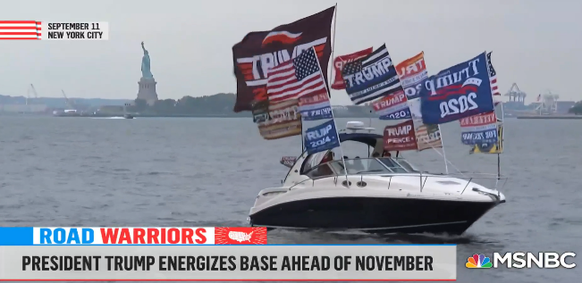
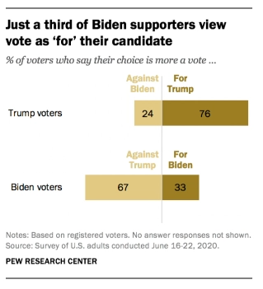
2020 Presidential Candidates
Voter Enthusiasm in Perspective
Enthusiasm among Trump supporters is much higher than it is among Biden supporters
76% of Trump supporters report that they are “for Trump,” while only 33% of Biden supporters are “for Biden”
Biden supporters are mostly motivated by being “against Trump”
Enthusiasm drives voter turnout. Trump hopes to motivate more of his supporters to vote than Biden gets among his supporters.
In 2016, black voters were not so enthusiastic to vote for Hillary Clinton. She may have won Wisconsin and Pennsylvania had she motivated more black voters to vote (see link to FiveThirtyEight.com below)
Notes:
https://www.pewresearch.org/politics/2020/06/30/publics-mood-turns-grim-trump-trails-biden-on-most-personal-traits-major-issues/
https://www.msnbc.com/craig-melvin/watch/katy-tur-on-the-president-s-base-donald-trump-is-truly-part-of-their-identity-92068421773 -- Source of Trump boat parade photo in NYC in Sept 2020
https://projects.fivethirtyeight.com/swing-states-2020-election/ -- see “538” comment about Wisconsin and Pennsylvania

Slide 21
Campaign Fundraising
Which Candidate Raised the Most Money??

Slide 22
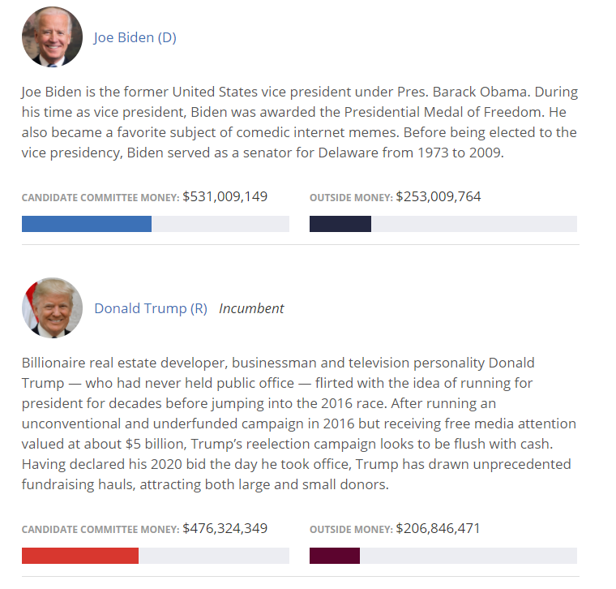
The 2020 Presidential Election Fund-Raising (Oct 2020)
With 15 days left in the campaign, Joe Biden has raised more money than Donald Trump
Usually, the winner raises the most money, but not always
In 2016, Hillary Clinton raised twice the amount of money as Donald Trump
Notes:
Source: https://www.opensecrets.org/pres16/ as of 10/28/2016

Slide 23
Campaign Controversies
Issues/Events
That May Have Potentially
Affected the Election Outcome

Slide 24
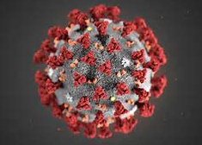
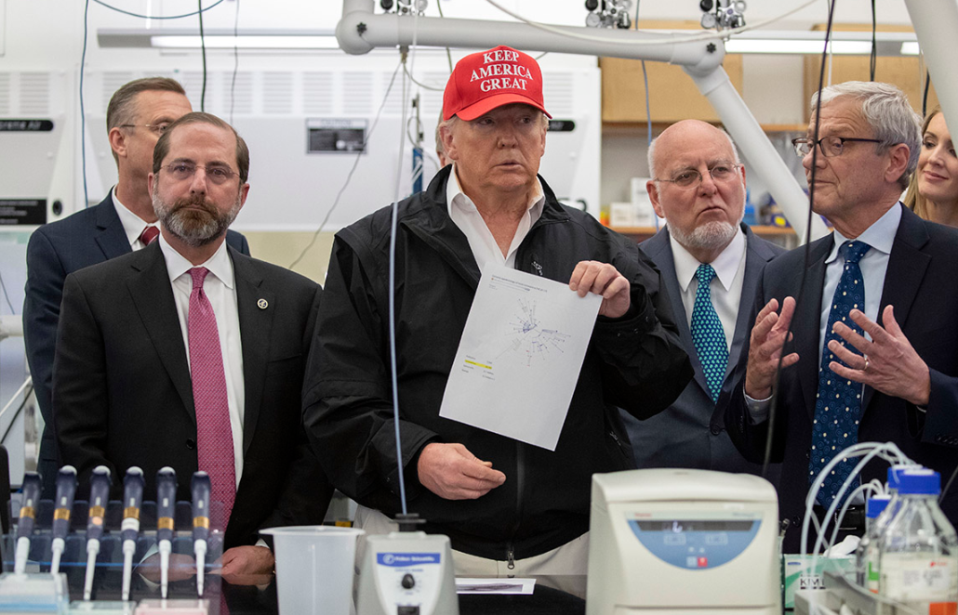
Trump’s Handling of the Coronavirus
Donald Trump’s Performance as a Crisis Leader (Mar-Oct 2020)
Trump at the CDC Mar. 6th 2020
Trump did not reflect the seriousness of the Coronavirus when the public first became aware of it
Wearing a MAGA hat is appropriate in some contexts, e.g., at a campaign rally, but wearing a MAGA hat did not project the gravity of a coming pandemic when Trump was getting informed about how deadly the virus might become
In September 2020, Bob Woodward published the book, “Rage,” in which Trump revealed that he intentionally downplayed the severity of COVID-19 in the March 2020 timeframe
How will Trump’s handling of the coronavirus affect the vote?
Notes:
CDC – Centers for Disease Control

Slide 25
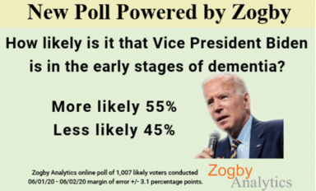
Joe Biden Mental Capacity
Suspicion that Biden has Early Stages of Dementia
Biden’s Mental Capacity
A Zogby poll in Summer 2020 showed that 55% of the public suspects that Biden may have early stages of dementia
During the coronavirus pandemic lockdown (Mar-May 2020) and through the summer (2020), Biden laid low at his home in Delaware, adding to suspicions that something was wrong
Though, at the DNC Convention (Aug 2020), the 1st presidential debate (Sept 2020), and other events, Biden has shown no signs of mental decline
Will Joe Biden’s mental stumbles hurt his chances of winning the presidential election?
Notes:
Biden’s stated reason for bunkering down at his home in Delaware was to stay safe from the coronavirus, and to comply with the guidelines of the Center for Disease Control (CDC).

Slide 26
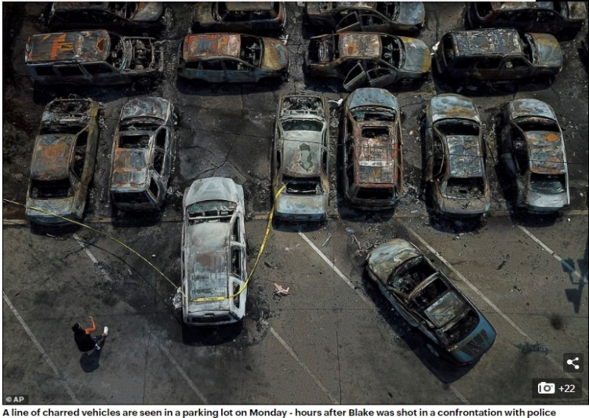
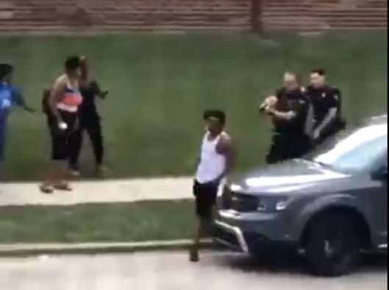
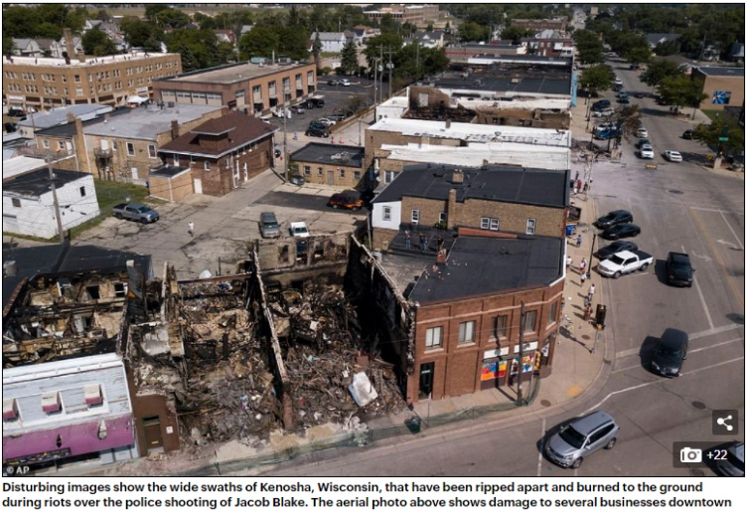
Violent Unrest in America
Violent Protests in Wake of Police Killing of George Floyd
Violent Protests in Kenosha, WI.
How will the voters respond to the violent unrest in America??
In August 2020, Jacob Blake was shot 7 times by police in Kenosha, WI. and violence protests ensued
Notes:
https://www.dailymail.co.uk/news/article-8679207/Photos-devastation-riot-torn-Kenosha-Trump-prepares-visit.html -- August 30, 2020
Jacob Blake resisted arrest and assaulted a police officer before he was shot 7 times, and amazingly, he survived. Blake was trying to flee the scene when he was shot. Parts of Kenosha was destroyed by violent protesters, and Trump has made “law and order” a campaign theme, hoping that he will win votes by calling out Democrat-run cities where violence is particularly bad in the wake of the police killing of George Floyd (in May 2020).

Slide 27
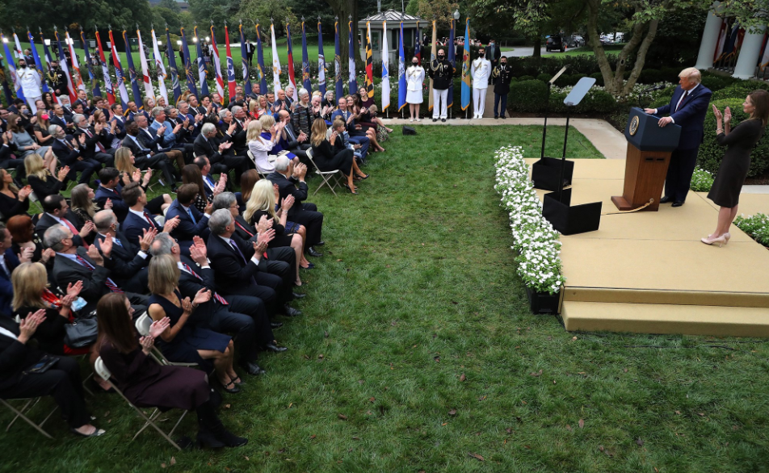
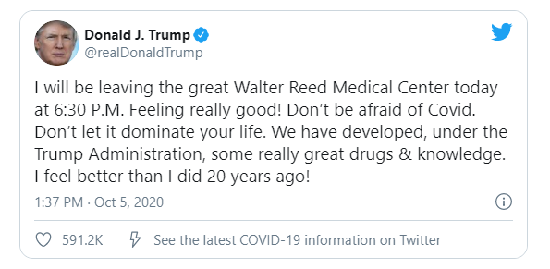
Trump’s Orientation Toward COVID-19
White House as a COVID-19 Cluster (Sept-Oct 2020)
The contrast that Trump has drawn in the 2020 presidential campaign is that he is willing to risk contracting COVID-19 to show the public that under his leadership he will not let COVID-19 dominate our lives, that we will learn to live with the virus, just as we do with the seasonal flu
But in early October (2020), Trump contracted COVID, and so did about 20+ others who work at the White House.
Will Trump be rewarded for being a risk-taker in the age of COVID-19? Or will Biden be rewarded for being risk-averse as this virus kills 200,000+ Americans?
Trump Contracts COVID-19
Notes:
The picture is of the Rose Garden ceremony for the nomination of Amy Coney Barrett to replace the late Ruth Bader Ginsberg on the U.S. Supreme Court (Saturday, Sept 26th 2020). Trump debated Joe Biden in the 1st Presidential Debate 3 days later in Cleveland, OH. (on Sept. 29th 2020). Hope Hicks, an advisor to the president, was diagnosed with COVID-19 two days later (Oct. 1st 2020), and the president and the First Lady were diagnosed with COVID-19 later that night. Trump was flown to Walter Reed Medical Center on Friday, Oct. 2nd (2020) and then released on Oct. 5th (2020), after an aggressive intervention by presumably the best doctors in the country. Trump came back to the WH in a dramatic helicopter ride and then walk up the back steps of the WH. He later released a video, repeating several times, “Don’t be afraid of the coronavirus. You can beat it. Don’t let it dominate your life.” This was a triple-down move on Trump’s part, because he was roundly criticized for making such “reckless” remarks, but Trump is betting American culture is still one of risk-taking and optimism, as opposed to the more cautious approach of Joe Biden, who is always seen wearing a mask and playing it safe, being risk-averse, in the age of COVID-19.
The Real Clear Politics average polling shifted strongly in Biden’s favor after the 1st debate and Trump’s contracting COVID-19. In a matter of about a week, Biden’s nationwide lead increased from about 7.5% to about 9.5% (which is a more significant shift because this is the average of the top 10+ polls). This polling shift indicates that Americans are more risk-averse than risk-taking, but the election is still one month away (at the time of this writing), so we’ll see if Biden’s strengthening in the polls continues…

Slide 28
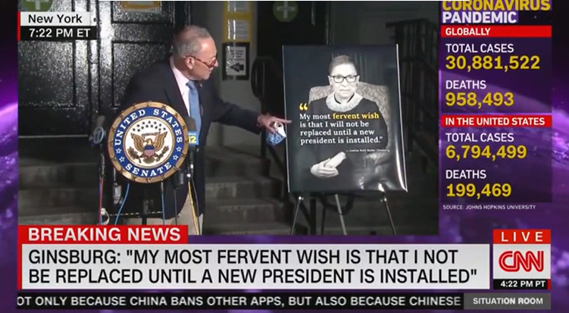
Nomination of Amy Coney Barrett
The Ideological Balance of the U.S. Supreme Court (Sept-Oct 2020)
Death of Ruth Bader Ginsberg
Ruth Bader Ginsberg died on 18 September 2020, opening a vacancy on the U.S. Supreme Court, which President Trump hopes to quickly fill will the nomination of Amy Coney Barrett
Trump could potentially flip a seat on the U.S. Supreme Court, given that Barrett is expected to rule as conservative, while Ginsberg ruled as liberal
Democrats have called Trump’s moving so quickly as a “crass exercise in power,” as Trump appeals to his religious and conservative base of support with the choice of Barrett
The U.S. Senate is majority-Republican, so it has the power to confirm Barrett prior to the 2020 presidential election
How will the voters respond to Trump’s quickly filling the vacated U.S. Supreme Court seat of Ruth Bader Ginsberg with Amy Coney Barrett?
Notes:
Source of picture: https://dailycaller.com/2020/09/21/chuck-schumer-alexandria-ocasio-cortez-americans-ruth-bader-ginsburg-scotus-seat-new-president/

Slide 29
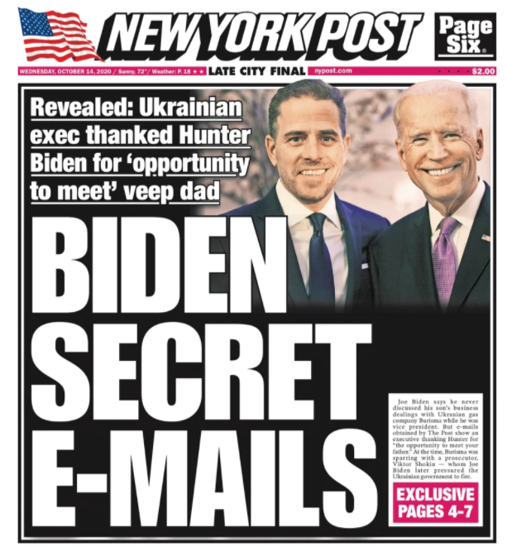
Joe Biden’s Corruption as VP??
Hunter Biden’s Lucrative Deals
Joe Biden-Hunter Biden
Corruption?
Did Joe Biden use his influence as VP to help his son, Hunter, gain lucrative deals in Ukraine, China, and elsewhere??
Twitter and Facebook censored the New York Post story, believing it to be corrupted by Russian intelligence interference in U.S. Elections
Conservatives news outlets, such as Fox News, have advanced this story as true, that a laptop, allegedly containing Hunter Biden’s emails was turned over to the FBI
Critics believe this story is false, a product of Russian disinformation
Will allegations of corruption hurt Biden’s chances of becoming president?
Notes:
https://nypost.com/2020/10/14/hunter-biden-emails-show-leveraging-connections-with-dad-to-boost-burisma-pay/ -- The story was published on 10/14/2020.

Slide 30
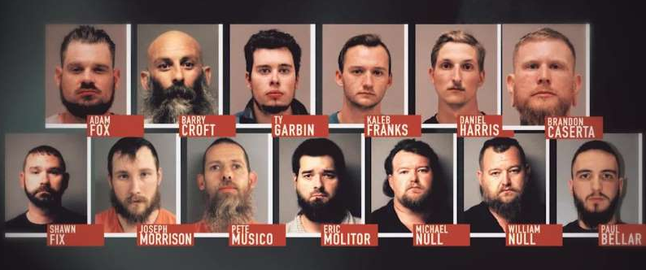
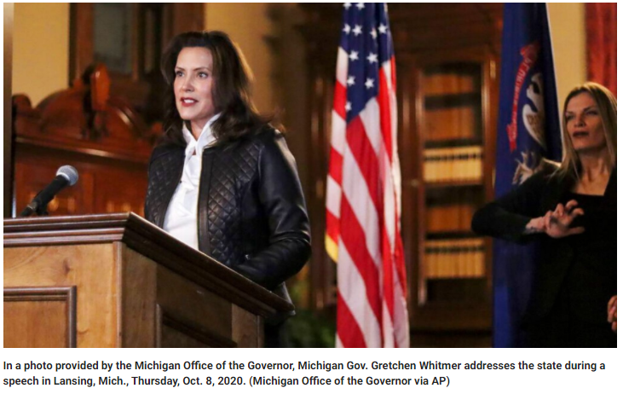
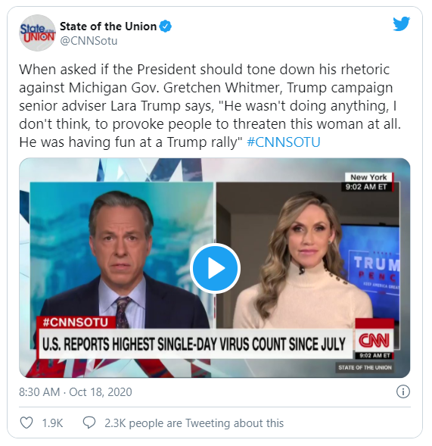
Violence Unrest in America
Militia Group in Michigan Plots to Kidnap Governor (Oct 2020)
President Trump and conservative elements in the media have personified Gov. Gretchen Whitmer as one who has imposed unreasonable lockdown policies on the people of Michigan
Essentially, Whitmer has been characterized as a left-wing authoritarian
In Oct 2020, the FBI foiled a plot of a militia group that had plotted to kidnap Gov. Whitmer, then try her for treason because of her lockdown policies
Gov. Whitmer blames President Trump for encouraging domestic terrorist organizations
A Plot to Kidnap Gov. Gretchen Whitmer (D-MI)
How will the voters respond to the violent unrest in America??
Notes:
https://www.npr.org/2020/10/18/925103289/michigan-gov-whitmer-says-trump-incites-domestic-terrorism – Whitmer’s response to Trump rallies where they chant, “Lock her up.”
https://www.foxnews.com/politics/michigan-whitmer-kidnapping-plot-details-emerge -- Background on the plot to kidnap Gov. Whitmer
A militia group in Michigan was plotting to kidnap Gov. Gretchen Whitmer (D-MI) for treason, presumably for coronavirus policies that are too restrictive. The FBI foiled the plan before it could unfold. Whitmer believes that Trump’s rhetoric and constant calling her out as an example of a Democratic governor who has employed unpopular lockdown policies encouraged this domestic terrorist group to come after her. Trump defended himself by responding that it was his Justice Dept. and FBI that had cased this group and prevented a crime from occurring before it could be carried out.

Slide 31
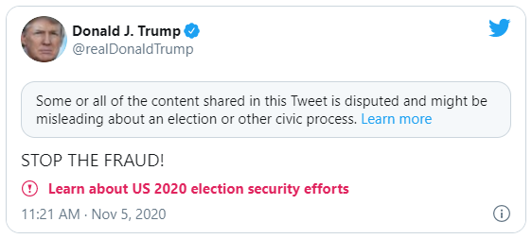
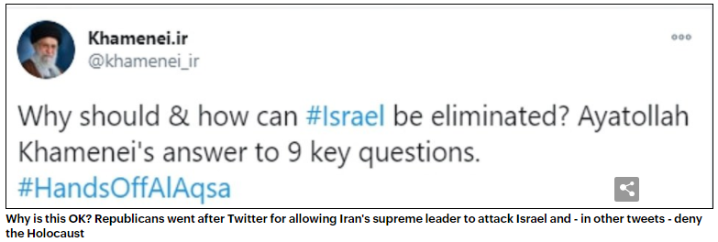
Unusually Fierce Opposition to Trump
Big Tech, Big Money, Big Polling, and the Administrative State
Twitter Flags “Misinformation”
Every president has fierce opposition, determined to defeat him in the next election, and to discredit the president in any way possible
But Trump was such an unorthodox president, being a businessman and not a career politician, and his “populist” authoritarian-leanings were more threatening than normal
There was a greater degree of opposition to Trump than is typical, from Big Tech, Big Money, Big Polling, and the administrative state (see notes below slide)
How will the voters respond to Twitter’s inconsistency in flagging “misinformation”?
This post-election Trump tweet is flagged by Twitter, because Twitter believes that claims of fraud without supporting evidence undermines election integrity
This tweet by the leader of Iran is NOT flagged by Twitter, despite Twitter’s ban on the glorification of violence
In 2020, “big tech” (Twitter, Facebook, Google, etc.) began to change policies on “misinformation,” particularly targeting conservative “misinformation.” This was in response to persistent criticism by the opposition to Trump’s tendency to lie and exaggerate, but conservatives object to being specially targeted, while others who propagate misinformation (or other dangerous speech) can still engage in free speech with no flags
Notes:
Explanation of Free Speech Standards
The legal standard for free speech as set by the U.S. Supreme Court, since 1969, has been that speech cannot incite violence or property damage. Let’s say that a leader of a cult instructs his followers to burn down buildings, then the police can arrest the leader of the cult, because his words are likely to incite violence by his gullible followers. But if the speaker is not likely to incite violence, such as if your professor (me) instructed you (my students) to burn down buildings (because my students would just look at me as a fool and not carry out my demands, since I don’t have the sway of a cult leader), then that speaker could not be jailed.
There all legal standards for libel and slander, i.e., written or spoken words that do material harm to another person. Let’s say that I defame one of my colleagues at HCC, and that colleague is fired, then that colleague could file a lawsuit against me because my lies harmed that person (that person would have lost his or her means of making a living, which would qualify as material harm).
In a free society, all other speech is permissible, but these rules don’t apply to a private business (like Twitter, Facebook, or Google). A private business can set its own rules, which is what Twitter has done. The complaint about Twitter, Facebook, and Google is that they have become so integral to our way of communicating that they too should respect the principles of free speech. A similar argument was made about the railroads in the late 1800s. At that time in our history, our society was so dependent on the railroads for transportation, travel, and commerce that eventually the courts in America defined railroads as a “public space,” and at that point, the government stepped in and began to regulate the railroads, such that they could not deny service (e.g., they could not deny service to black people). Something similar might happen to Big Tech, because Republicans and conservatives don’t think it is right to deny their side of their free speech rights, when others can still engage in free speech. Republicans and conservatives view this as censorship, which is a different type of authoritarian behavior (different from Trump’s populist authoritarian tendencies). Democrats and liberals are comfortable with censorship of conservative “misinformation,” but they find Trump’s populist authoritarianism very threatening (e.g., cracking down on illegal immigration, picking a fight with China over trade issues, etc.)
This is a debate that will outlast the 2020 presidential election.
Big Money: Michael Bloomberg’s Monetary Efforts to Defeat Trump
https://www.msn.com/en-us/news/politics/michael-bloomberg-spent-dollar1-billion-this-election-cycle-and-is-coming-away-with-huge-losses/ar-BB1aHwFs – This article details the money Micheal Bloomberg spent to defeat Donald Trump and Republicans generally. Bloomberg spent millions of dollars in ads in Ohio, Texas, and Florida, such that the Biden campaign would not have to spend as much in those states (though the campaigns did not officially coordinate this arrangement because campaign laws prohibit such coordination). Others, besides Bloomberg, poured money into races against Mitch McConnell (R-KY), Lindsey Graham (R-SC), and John Cornyn (R-TX), all races that were easily won by these Republicans Senators, but the threat of having massive amounts of money poured into their competitors is intended to scare these incumbent Senators, and Lindsey Graham and John Cornyn were terrified in the final days of the campaign, worried that their opponents would actually defeat them (Mitch McConnell was not as threatened by his competitor and the money spent to defeat him).
Big Polling: Polling Errors
https://www.usnews.com/news/elections/articles/2020-10-28/biden-opens-gaping-17-point-lead-on-trump-in-wisconsin-poll-finds – This is the most absurd poll of the 2020 election, showing Biden up by 17% in Wisconsin one week before Election Day. On Election Day (or 1 or 2 days after), Biden had won Wisconsin by 0.4%, which is a very close margin.
https://fivethirtyeight.com/features/the-polls-werent-great-but-thats-pretty-normal/?cid=taboola_rcc_r
-- This article defends polling errors by claiming that the public has a misperception about the accuracy of polls.
Big Tech: Twitter Policies
https://www.dailymail.co.uk/news/article-8888985/GOP-senators-slam-Facebook-Twitter-censorship-suppression-conservative-voices.html – This article reports on the Senate hearing into Big Tech’s “censorship” of mostly conservative “misinformation,” e.g., that Joe Biden used his influence to help enrich his son and brother v. those who say that the Holocaust was fake, which are tweets that are not flagged as misinformation.
https://www.factcheck.org/2020/11/trump-tweets-flagged-by-twitter-for-misinformation/ -- Here is a list of 9 of Trump’s post-election tweets and why they were flagged by Twitter. Clearly, Trump was wrong to claim he was robbed of an election victory, but the point of the slide above is to highlight the inconsistency of Twitter, flagging Trump’s “misinformation” but other forms of misinformation, such as those who deny that the Holocaust actually happened—these tweets are tolerated as free speech, and free speech can be false (though knowingly false speech that does material harm to another person can be punished as libel or slander).
https://www.stljewishlight.com/news/world/two-weeks-after-twitter-bans-holocaust-denial-twitter-s-ceo-says-it-s-still-allowed/article_47de9db2-333c-520f-8c1b-4897a323737e.html – Jack Dorsey lays out the criteria for Twitter flags: misinformation regarding public health, election integrity, and manipulation of media content. Twitter also has policies against the glorification of violent events, especially against those who are protected minorities, so if someone glorifies the Holocaust, that would be flagged, but if someone questions that the Holocaust existed, that would not be flagged. Dorsey seems to also imply, as reported in this article, that Twitter has a policy against hate speech, which would include a ban on Holocaust denial.
Big Tech: Google Policies
https://www.nationalreview.com/news/google-bans-the-federalist-from-generating-ad-revenue-after-intervention-by-nbc-news/ -- Google demonetizes The Federalist for some sort of racial bias or hate speech (the article does not specify what The Federalist did wrong to violate Google policies). The Federalist is a conservative organization that Donald Trump catered to as president. The Federalist came up with a list of qualified people who could be potentially appointed to the U.S. Supreme Court. Trump chose 3 people from the list as nominees to the U.S. Supreme Court during his term in office.
https://www.thestreet.com/investing/google-boots-zerohedge-federalist-off-ad-platform – Google denies demonetizing The Federalist.
The Administrative State
Trump calls the FBI and intelligence agencies “the deep state,” because many of the career bureaucrats and appointees who head these bureaucracies were opposed to Trump’s unorthodoxy, especially his often times dismissal of their expert advice and of normative standards that past presidents have followed, but not Trump. During the 2016 campaign and during the transition from the Obama administration to the Trump administration (2016-17), there were high level FBI personnel actively working against Trump. When Trump was impeached for the scandal involving Ukraine, Trump tried to counter by highlighting the FBI spying on his campaign in the 2016-17 timeframe, but it did not work, and the impeachment went forward.
Many officials who worked for Trump, after leaving his administration, spoke out against him, believing him to be an idiot or even reckless and dangerous. These officials are further examples of what Trump called “the deep state.”

Slide 32
Presidential Election Outcome
Joe Biden Defeats Donald Trump

Slide 33
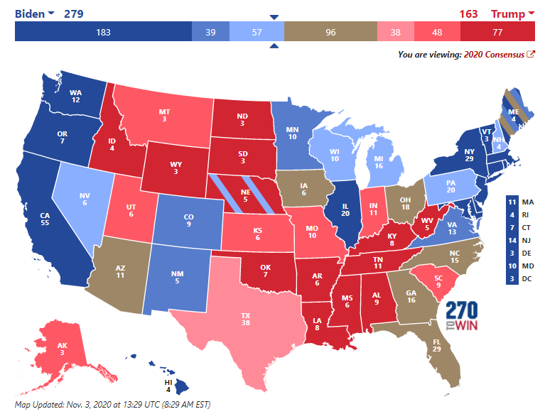
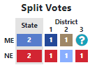
Election Day Predictions
270towin.com: Nov. 3rd 2020
270towin.com predicted a Biden victory on Election Day
Some of the states 270towin.com’s consensus of 9 organizations defined as toss-ups were called on Election Night: Iowa, Ohio, Florida (and ME-2)
Some of toss-ups took more than a week to call: Arizona, Georgia, and North Carolina
Pollsters found it very difficult to poll the “shy” Trump voter in the Midwest states: Iowa, Wisconsin, Michigan, Ohio, and Pennsylvania
Notes:
A “shy” Trump voter was one who would not tell a pollster that he or she intended to vote for Trump.
Source: http://www.270towin.com/
Date: Nov. 3rd 2020
https://www.270towin.com/content/forecasts-in-the-2020-consensus-map
Below is a cut and paste from the link above:
Forecasts in the 2020 Consensus Electoral Map
The Consensus Electoral Map aggregates the ratings from the following to come up with a composite forecast for the 2020 presidential election.
Full-time Analysts
Sabato's Crystal Ball
The Cook Political Report
Inside Elections
Statistical Models
The Economist
FiveThirtyEight
Prediction Markets
PredictIt
Media Analysis
Politico
CNN
U.S. News
To arrive at the consensus map, we assign a party-specific point value to each rating category (safe, likely, leaning, toss-up). From there we calculate the average rating. Those average ratings determine the consensus rating, which may or may not be the most frequent one. Only states rated safe by seven or more of the nine forecasts are shown in the darkest shade of blue or red on the map. This allows for a more inclusive look at states that could be competitive in the right circumstances.

Slide 34
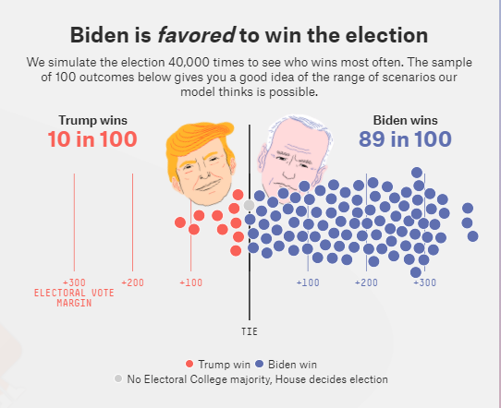
Election Day Predictions
FiveThirtyEight.com: Final Forecast
FiveThirtyEight.com forecast that Biden had an 89% chance of winning the election, while Trump had a 10% likelihood of winning
In 2016, “538” forecast that Hillary Clinton had a 73% chance of victory, yet Trump still won that election
One day prior to the 2020 election, “538” posted a statement that Trump still had a narrow path to victory, but on Election Day, it turned out that “538” predicted the correct winner in 2020
Biden’s actual election victory was close to this point in the range of possibilities
Notes:
https://projects.fivethirtyeight.com/2020-election-forecast/
https://fivethirtyeight.com/features/im-here-to-remind-you-that-trump-can-still-win/

Slide 35
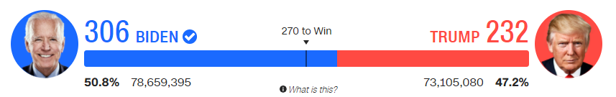
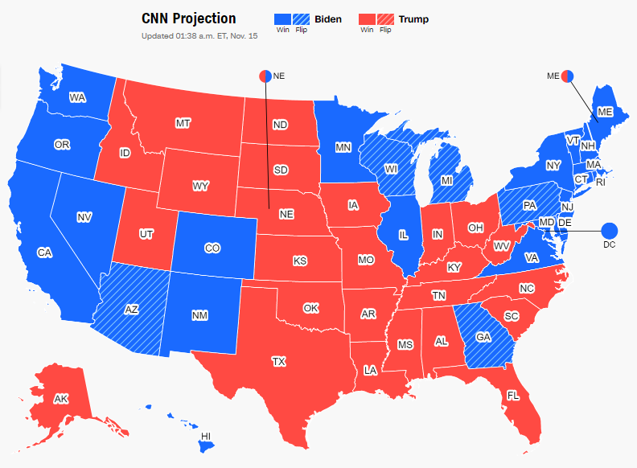
2020 Election Results
The Electoral Vote
In 2020, Biden flipped Arizona, Georgia, Wisconsin, Michigan, and Pennsylvania, all states that Trump had won in 2016
Biden also flipped NE-2, a district Trump had won in 2016
Biden’s 306 to 232 victory was the exact same margin by which Trump defeated Hillary Clinton in 2016
Notes:
Both the Democratic and Republican parties concentrated on GOTV (Get Out The Vote) in 2020, and both were very successful. Biden’s vote totaled more than 13 million more voters than Hillary Clinton in 2016, and Trump exceeded his 2016 vote total by 11 million votes. Trump’s voters had more enthusiasm (as measured in polls), but Biden’s voters were equally or more motivated to end the Trump presidency. Voting against the other candidate doesn’t usually motivate as many voters as voting for one’s own candidate, but 2020 was an exception to that rule. Democrats voted against Trump in larger numbers than Trump’s more enthusiastic voters came out to vote for him.
The 2004 presidential election is one example where the motivation to “vote against [a candidate]” was not strong enough to defeat an incumbent president. The anti-Bush (George W. Bush) sentiment in 2004 was very strong, given the Democrats’ fierce opposition to Bush’s initiation of the Iraq War the year before, but Democrats could not motivate enough voters to come out to vote to defeat George W. Bush. Though, it was a close election. It came down to one state, Ohio, which Bush won 51% to 49%. [The Democratic candidate for president in 2004 was longtime U.S. Senator John Kerry. Kerry later served as President Obama’s Secretary of State in Obama’s second term in office.] But in 2020, the motivation to defeat Trump was strong enough to get enough Democrats out to vote to push Joe Biden to victory.
It seems to me that the 2020 presidential election was more akin to the 1992 presidential election (in which Bill Clinton defeated incumbent president George H.W. Bush, the father). The motivation to “vote against” the incumbent president, George H.W. Bush (the father, the son was elected later, in 2000) was very strong in 1992, just as it was against Trump in 2020. Like Trump, Bill Clinton had serious character flaws, being a womanizer and liar, so the motivation to “vote for” Bill Clinton was not as strong (when Clinton ran for reelection in 1996, there was much stronger motivation to “vote for” Clinton, but not in 1992). The motivation to vote against Bush was so strong because Democrats viewed the Reagan-Bush 12-year era as a disaster (Reagan was president from 1981-1989 and Bush was president from 1989-1993) for the country. They felt that Reagan-Bush had reversed, or undercut, so many liberal gains in previous eras (on civil rights, abortion, health care, welfare, etc.) and that the country just couldn’t take another 4 years of conservative policies (just like Democrats couldn’t take another 4 years of Trump policies). After the 1992 presidential election, political scientists analyzed media messages during the election and found that 90% of media reporting about Bush was negative. So, in 1992, the “dominant” media was on the side of the Democrats, essentially encouraging the public to vote against Bush. This was the case in 2020 as well (except Trump also had Twitter and Facebook against him, neither of which existed in 1992), and when political scientist study media messages in 2020, they will find that an overwhelming amount of reporting on Trump was negative (though Fox News was more positive toward Trump, and Fox News did not exist in 1992).
There are some differences between 1992 and 2020, as we would expect. For instance, it took 12 years of Reagan-Bush policies to motivate enough Democrats to vote against Bush in 1992, while it took only 4 years of Trump policies (and behaviors) to motivate enough Democrats to vote against Trump in 2020.
The motivation to “vote against” is not typically enough to defeat an incumbent president, but there are exceptions to that rule, and 1992 and 2020 are two examples where the exception prevailed.

Slide 36
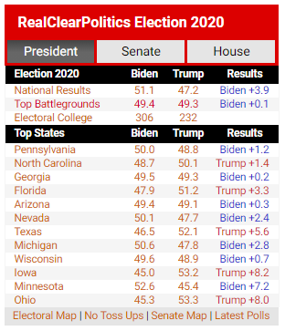
The 2020 Election Results Real Clear Politics Summary
National and Battleground State Results
Biden won by a comfortable margin in the popular vote nationwide
The split in the popular vote in the battleground states was very close
The RCP average polling called some states within 1%, which is about as accurate as we can hope for polling data
While the RCP average polling was off by 4% to 7% in other states, which falls way below our expectations for accuracy in polling data
Notes:
See notes on Slide 40 for the accuracy in each battleground state poll.

Slide 37
2020 Presidential Election Why Joe Biden Defeated Donald Trump
Why Biden Won?
A Simple Explanation: 80 million Democratic voters tired of Trump’s twitter rants and mean and childish attacks on his political opponents (while 74 million Republican voters appreciated Trump’s defiance of “the swamp”)
Perhaps a Better Explanation: Biden matched-up better against Trump in 2020 than Hillary Clinton did in 2016
Valence Issues (Character Traits)
Empathy in a Crisis – Biden is empathic of others who have experienced tragedy, having lost his first wife and daughter in a traffic accident, and empathy is preferred during a pandemic
Allegations of Corruption – The perception that Biden had used his position in government to enrich his family (son + brother) was neutralized by Trump’s using his position in business to enrich his family
Health – There are suspicions that Biden has early signs of dementia, but Biden never had a serious “senior moment” during the campaign, so Biden’s mental acuity exceeded the expectations set by his detractors
Policy Issues
Coronavirus – Both candidates drew a clear line on their respective approaches to the coronavirus, Trump showing no fear (no more lockdowns), Biden being more cautious (and empathetic) (follow CDC guidelines), and the voting public was more comfortable with being more cautious (and empathy is a great trait to have in a crisis)
Violence in the Streets – Biden was slow to weigh-in on the protests, looting and violence post-George Floyd, but ultimately, Biden neutralized Trump’s potential advantage by agreeing that violence is unacceptable
Notes:
The Economy
What about the economy? The economy was on path to a full recovery prior to Election Day, with economic growth at 32% in the last quarter before the election (though the economy had still not fully recovered from the economic collapse in March-April 2020, due to the coronavirus lockdowns), but Trump didn’t seem to benefit from being perceived as a better steward of economic growth than Joe Biden (Trump’s one consistent lead in the polls was on who would better handle the economy). It seems to me that the anti-Trump sentiment (objections to his unorthodox behavior as president, e.g., twitter rants) and Trump’s failure as a crisis leader during the coronavirus pandemic were the most significant factors in 2020.
Trump’s Coronavirus Gambit
Being a real estate tycoon, Trump is a man of action; ultimately, skyscrapers and resorts are built (in contrast to the typical politician, who just talks and talks and talks but rarely delivers anything). So, during the coronavirus pandemic, Trump fell back on this strength, using his powers as president to remove bureaucratic “red tape” so that the drug companies could produce a vaccine much faster than under normal circumstances. The initiative was called “operation warp speed.” Trump sensed that the devastating affects of the coronavirus on our economy, not to mention the mounting death toll, could result in an Election Day loss, and since he is not a crisis leader, meaning he does not have a calming effect on a public that is prone to panic during a crisis, Trump’s political survival depended on getting an effective vaccine to the American people, which would allow us to return to normal (and end the anxiety amongst the voting public). It was a race against time, and Trump ran out of time. Just 2 weeks after the election, Moderno and Pfiser, two drug companies, reported that their novel coronavirus vaccines had been tested and that they were 95% effective. Trump needed this news a month before the election, but it didn’t happen until after the election.
Other Explanations for the Outcome of the Election
There were other factors that led to a Biden victory: 1) he ran a smart campaign, laying low and making fewer public appearances, letting the spotlight be on Trump and making it a referendum on Trump, 2) plenty of power centers were on Biden’s side, even disaffected Republicans who opposed Trump, as well as the dominant media, which put little pressure on Biden, and Big Tech started to “flag” Trump’s tweets as “misinformation,” and most polling organizations predicted a large Biden victory (many polls were not accurate), which may have had a demoralizing effect on some Trump supporters.
https://thefederalist.com/2020/11/13/5-historical-trends-that-show-its-utterly-shocking-if-trump-lost-in-2020/ -- An interesting article suggesting that there were signs that indicated Trump should have won in 2020.

Slide 38
Post-Election Analysis
How Accurate were the Polls?
Notes:
https://thefederalist.com/2020/11/12/yes-the-2020-polling-was-terrible-and-theres-no-excuse/

Slide 39
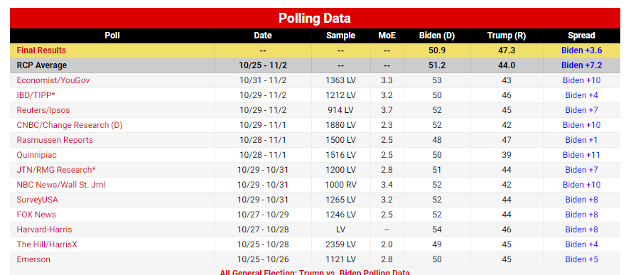
2020 Presidential Campaign
Real Clear Politics (RCP) National Average
The RCP national average poll over-predicted Biden’s share of the vote by 3.6%. However, unlike in 2016, in 2020, the RCP national average poll called the right winner (Biden), while in 2016, it incorrectly had Hillary Clinton winning.
Through media reporting, we (the voter) have come to expect polls to be more accurate than they turn out to be.
Notes:
https://www.realclearpolitics.com/epolls/2020/president/us/general_election_trump_vs_biden-6247.html

Slide 40
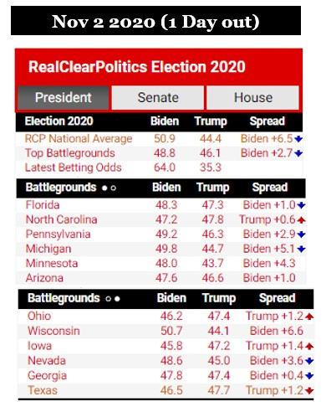
The 2020 Presidential Election Polling Errors in the Battleground States (11/2/2020)
Battleground State Results
Wisconsin
Biden won by a margin of 0.6% (49.4% to Trump’s 48.8%)
Michigan
Biden won by a margin of 2.6% (50.5% to Trump’s 47.9%)
Ohio
Trump won by a margin of 8.1% (53.3% to Biden’s 45.2%)
Pennsylvania
Biden won by a margin of 1.1% (49.9% to Trump’s 48.8%)
Florida
Trump won by a margin of 3.3% (51.2% to Biden’s 47.9%)
North Carolina Trump won by a margin of 1.3% (49.9% to Biden’s 48.6%)
Georgia
Biden won by a margin of 0.3% (49.5% to Trump’s 49.2%)
Arizona
Biden won by a margin of 0.3% (49.4% to Trump’s 49.1%)
Texas Trump won by a margin of 5.7% (52.1% to Biden’s 46.4%)
Notes:
Source: https://www.cnn.com/election/2020/results/president – 11/16/2020
Here are two more battleground states in 2020:
Iowa
Trump won by a margin of 8.3% (53.2% to Biden’s 44.9%) – The RCP average polling under-estimated Trump’s margin of victory by 6.9%, which was the largest polling error in any state (tied with Ohio).
Nevada Biden won by a margin of 2.4% (50.1% to Trump’s 47.7%) – The RCP average polling over-estimated Biden’s margin of victory by 1.2%, which is pretty close.
Minnesota
Biden won by a margin of 7.1% (52.5% to Trump’s 45.4%) – The RCP average polling under-estimated Biden’s margin of victory by 2.8%, which was the only battleground state in which Biden’s share of the vote was under-estimated by the RCP average polling data.
The other battleground states (on the slide) – did the RCP average polling data over-estimate or under-estimate the candidate’s actual vote share on Election Day??
Wisconsin
Biden won by a margin of 0.6% (49.4% to Trump’s 48.8%) – The RCP average polling over-estimated Biden’s margin of victory by 6.0%
Michigan
Biden won by a margin of 2.6% (50.5% to Trump’s 47.9%) -- The RCP average polling over-estimated Biden’s margin of victory by 2.5%
Ohio
Trump won by a margin of 8.1% (53.3% to Biden’s 45.2%) -- The RCP average polling under-estimated Trump’s margin of victory by 6.9% (tied with Iowa for the largest average error)
Pennsylvania
Biden won by a margin of 1.1% (49.9% to Trump’s 48.8%) -- The RCP average polling over-estimated Biden’s margin of victory by 1.8%
Florida
Trump won by a margin of 3.3% (51.2% to Biden’s 47.9%) -- The RCP average polling under-estimated Trump’s margin of victory by 4.3%
North Carolina Trump won by a margin of 1.3% (49.9% to Biden’s 48.6%) -- The RCP average polling under-estimated Trump’s margin of victory by 0.7%
Georgia
Biden won by a margin of 0.3% (49.5% to Trump’s 49.2%) -- The RCP average polling over-estimated Biden’s margin of victory by 0.1%
Arizona
Biden won by a margin of 0.3% (49.4% to Trump’s 49.1%) -- The RCP average polling over-estimated Biden’s margin of victory by 0.7%
Texas Trump won by a margin of 5.7% (52.1% to Biden’s 46.4%) -- The RCP average polling under-estimated Trump’s margin of victory by 4.5%
------------------------------------------------------------------
3rd Party candidates won a far lower % of the vote than they did in 2016. Some believe that Hillary Clinton lost the 2016 election because she lost votes that would have otherwise been cast for her to a 3rd Party candidate, namely, Jill Stein (Green Party). In 2020, “The Federalist” published a piece that claims that the Libertarian candidate turned the election for Joe Biden, that the Libertarian (Jo Jorgensen) won enough votes to turn the election for Biden (against Trump).

Slide 41
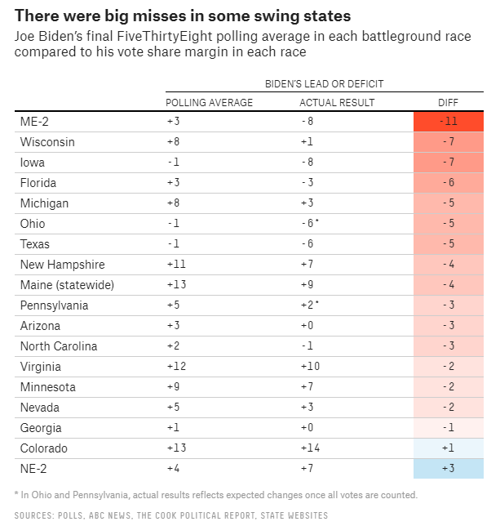
2020 Presidential Campaign
FiveThirtyEight.com Battleground Predictions
The various shades of red indicate the degrees to which Trump’s vote share was under-estimated by the polls inputted into the “538” forecasting model
The “shy” Trump voter was very hard to measure in the Midwest and Northern states: Maine (District 2), Wisconsin, Michigan, Ohio, Pennsylvania
“538” forecasting model failed to include polls that measured Trump voters well in 2016, so in the 4 years in between, most pollsters still did not figure out how to make Trump supporters feel comfortable enough to be honest when speaking to pollsters
Notes:
https://fivethirtyeight.com/features/the-polls-werent-great-but-thats-pretty-normal/?cid=taboola_rcc_r
Notice that the polling errors (when compared to actual election outcomes) were greater in the Midwest states (Wisconsin, Iowa, Michigan, Ohio) and in Maine (upper Northeast) than they were in the sunbelt states (Arizona and Georgia but not Texas, where the polling error was fairly large). Why is this? Here is my speculation as to why. The Midwest states and Maine are perceived to be more liberal-minded than the sunbelt states, though that perception may not be true, I think the perception is real. So, given the differences in perception, Trump supporters in the Midwest and Maine may be more reluctant to be open in their support of Trump (the “shy” Trump voter) because they perceive their political culture to be more liberal, while Trump supporters in Georgia (perceived as a more conservative state) and Arizona (perceived as a more libertarian-conservative state) may feel more comfortable being more open about their support for Trump because they perceive their respective political cultures to be more conservative, and thus more accepting of a Trump supporter. My thesis may be right, or it may be wrong, but one thing is for sure, the pollsters were much more accurate in predicting the actual vote in the sunbelt states than they were in the Midwest states and Maine.

